Slide 1
Diagnostic Modality of breast Lump by radiology
BY
Col.Dr.Marwan Almarwani, M.D SSC- Rad
King Fahad Armed Forces Hospital-Jeddah
Body MRI, Breast & Interventional Consultant Radiologist
McGill University Fellowship
Montreal-Canada

Slide 2
Breast Anatomy

Slide 3
Diagnostic mammography forms the foundation of diagnostic evaluation of breast lump in women age 40 and above.
Spot compression, lateral and rolled views.
Sensitivity (70-90%) and specificity (75%)
False negative 10-30% higher in younger women and dense breast.

Slide 4
51 y.o woman

Slide 5
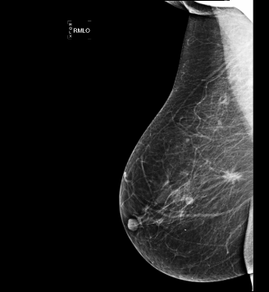
54y.o woman

Slide 6
.
Digital tomosynthesis
Takes multiple X-ray pictures of each breast from many angles.
The breast is positioned the same way it is in a conventional mammogram, but only a little pressure is applied — just enough to keep the breast in a stable position during the procedure.
The X-ray tube moves in an arc around the breast while 11 images are taken during a 7-second examination.
Recent studies indicate about 30% increased DBT sensitivity and specificity compared to FFDM with a recalls reduction in screening by approximately 40%.

Slide 7
Digital tomosynthesis of the breast is different from a standard mammogram in the same way a CT scan of the chest is different from a standard chest X-ray. Or think of the difference between a ball and a circle. One is 3-dimensional, the other is flat.

Slide 8
Digital breast tomosynthesis is a new kind of test that's trying to overcome three big issues in mammogram:
The compression of the breast that's required during a mammogram can be uncomfortable. Some women hate it, and it could deter them from getting the test.
The compression also causes overlapping of the breast tissue. A breast cancer can be hidden in the overlapping tissue and not show up on the mammogram.
Mammograms take only one picture, across the entire breast, in two directions: top to bottom and side to side. It's like standing on the edge of a forest, looking for a bird somewhere inside. To find the bird, it would be better to take 10 steps at a time through the forest and look all around you with each move.

Slide 9
Right craniocaudal FFDM image shows an indistinct mass in the central breast. Right craniocaudal DBT image shows an irregular mass (circle) with spiculated margins. Biopsy demonstrated invasive ductal carcinoma

Slide 10
Left craniocaudal FFDM image shows irregular mass with indistinct margins in the left central breast. Left craniocaudal DBT image shows irregular spiculated mass with distortion more visible because of the removal of overlapping tissue at DBT. Biopsy demonstrated invasive carcinoma

Slide 11
Ultrasonography
Generally used to assist the clinical examination of a suspicious lesion detected on mammography or physical examination.
More sensitive than mammography to detect cancer in dense breast and younger women,
Heterogeneous dense breast (sensitivity): Mammography 24%
Ultrasound 60%
But it is limited by a number of factors, most notably:
1-failure to detect microcalcifications
2- poor specificity (34%).

Slide 12
Elastography
Shear wave and strain.
Measure the tissue stiffness.
Breast cancer is stiffer than benign lesion.
Decrease number of biopsy, improve specificity and accuracy up to 80-90%
Shear wave velocity cut-off of 3 m/s

Slide 13
32y.o woman (triple negative IDC)

Slide 14
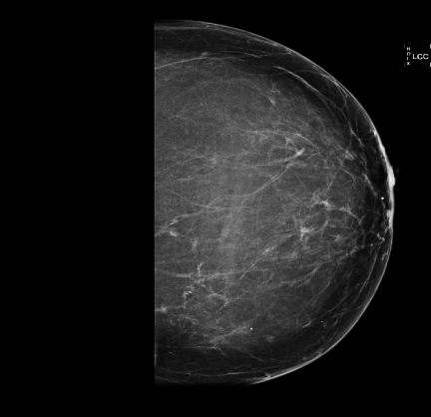
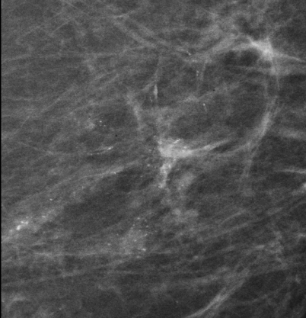
Micropure software option: to detect microcalcifications
52y.o cluster of Micro calcifications around 9 o’clock

Slide 15
US guided biopsy(micropure) =ADH

Slide 16
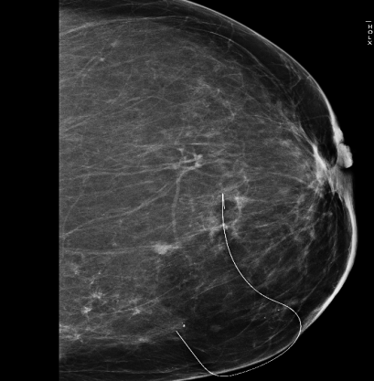
Stereotactic guided wire loc. Followed by lumpectomy = DCIS & IDC

Slide 17
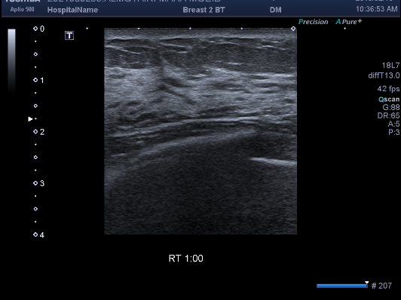
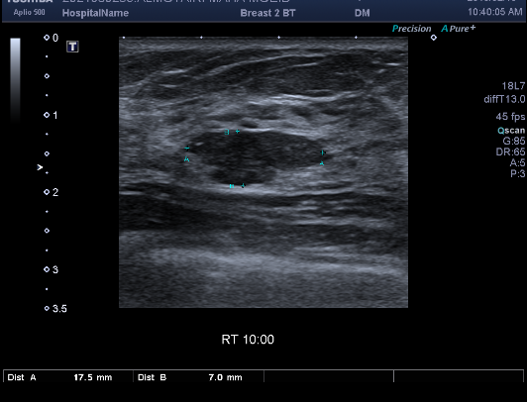
Ultrasound Beaware of: Ghost cancer
35y.o woman with right breast lump

Slide 18
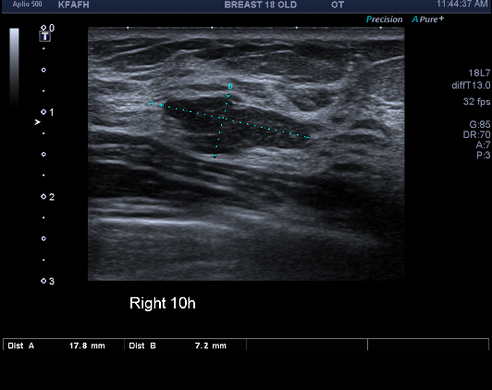
After 8 months

Slide 19
Ultrasound done by Radiologist over the clinical lump

Slide 20
The biopsy demonstrated invasive carcinoma

Slide 21
On ultrasound
Always remember :
Check the case yourself (Radiologist) after the tech.
Correlates clinically: take history and examine your patient.
Target scan: place the probe over the clinical lump

Slide 22
Breast MRI
Many indications the most important is: staging & staging & staging
Not to solve a problem, 1% only
Mammography+Ultrasound & Biopsy is the way to go for diagnosis of breast lump.

Slide 23
The most accurate modality for disease extent and size
1.6X1.5cm
3.7X1.7cm
2.5X2.3cm

Slide 24
Thank you

